Slide 1
Analysis of Emergency - 911 Calls from Montgomery County, PA
Jinesh Dhruv

Slide 2

History
The 911 has been designated as the "Universal Emergency Number," for citizens throughout the United States to request emergency assistance
In 1968, 911 became the national emergency number for the United States
The calls are placed by a Voice over Internet Protocol (”VoIP”) End-User to Carrier’s Internet Protocol (”IP”) services
https://encrypted-tbn1.gstatic.com/images?q=tbn:ANd9GcQHGDjUKfSh3mC-k7gZP7RXmX1p4yGm40go2LrhLmBag3XjFzGBBA

Slide 3
Importance of 911 Call Analysis
A good understanding of expected 911 calls might help with resource allocation for 911 call centers
Reduce the stress of the 911 operators, who suﬀer from signiﬁcant employee turnover
Help strategy makers anticipate the occurrences of emergencies and enable them to effectively handle the emergency by appropriate allocation of resources
http://www.ijais.org/archives/volume11/number7/selvam-2016-ijais-451632.pdf

Slide 4
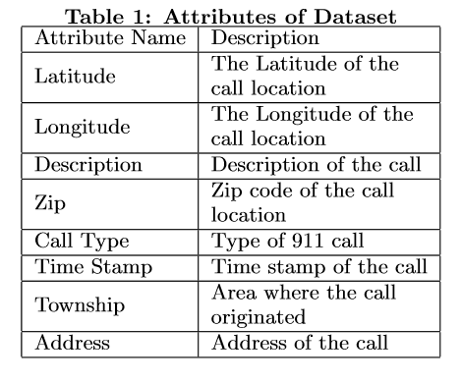
DATASET
The dataset was collected from Kaggle & consist of 188752 entries
The data is collected between 12/10/2015 to 04/13/2017
https://www.kaggle.com/umeshnarayanappa/explore-911-data/notebook

Slide 5
Issues With Dataset
Extract Time-Date from Timestamp
22000 Missing Values of Zip Codes
Categorize Emergency Calls
Challenges
Solution
Google Maps API
Python Script

Slide 6
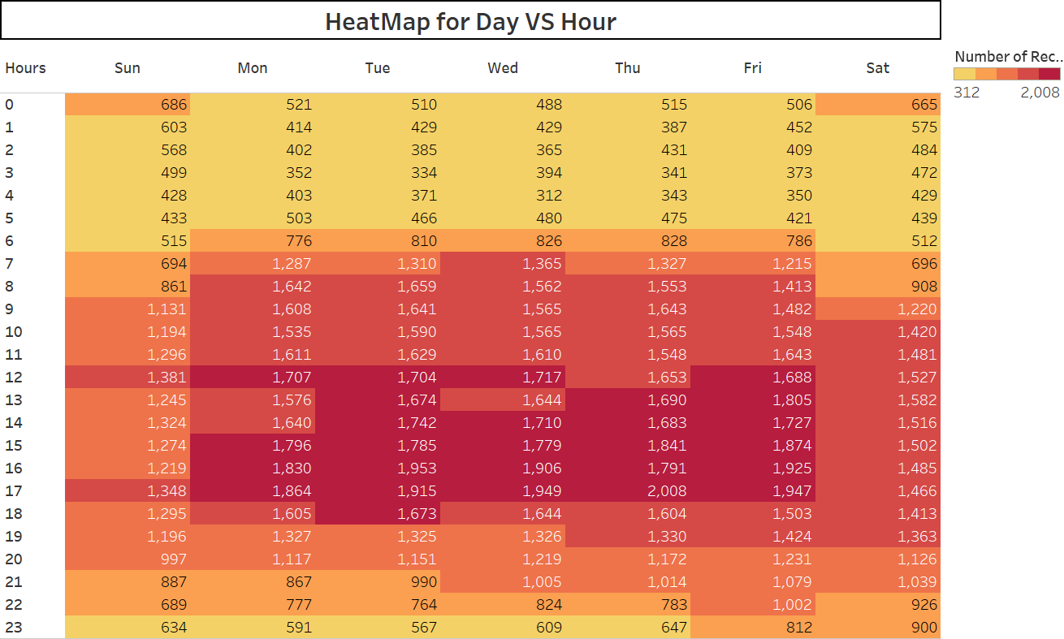
Data Visualization & Interpretation
Most of the 911 calls occur during weekdays between 3pm to 5pm
Increase in calls past 11:00 PM on Friday and Saturday nights

Slide 7
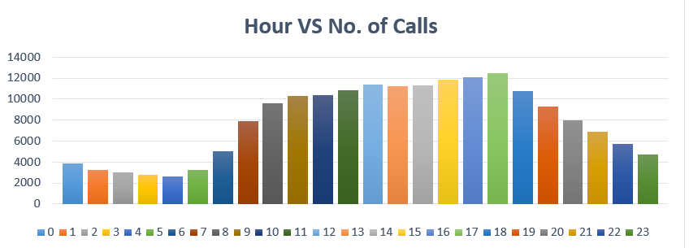
Data Visualization & Interpretation
Most of call occurs between 10 am to 5pm
Could be because lot of people travel and work at this time

Slide 8
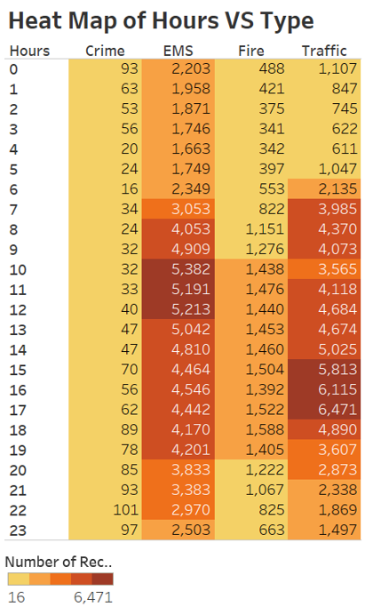
Data Visualization & Interpretation
Supports our previous idea that lot of people travel and work between 10am to 5pm
So, there are more chances of having traﬃc accidents and medical emergency compared to other time

Slide 9
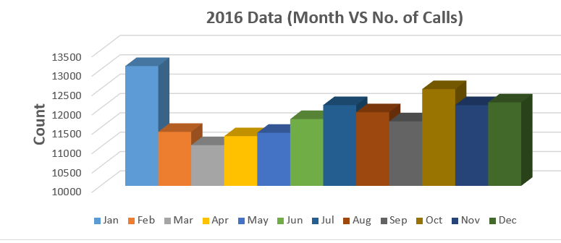
Data Visualization & Interpretation
Is their any speciﬁc month when 911 calls are highest or lowest ?
There was an exceptionally heavy snow storm from Jan 22nd to Jan 24th, 2016

Slide 10
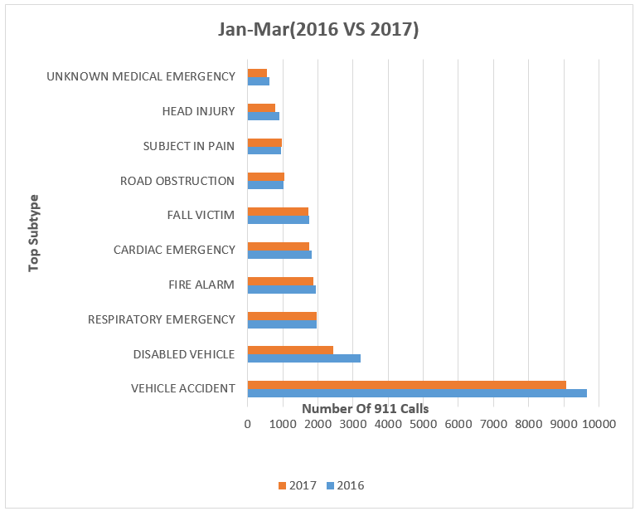
Data Visualization & Interpretation
Calls have been reduced in 2017
No natural calamity like snowstorm in 2017

Slide 11
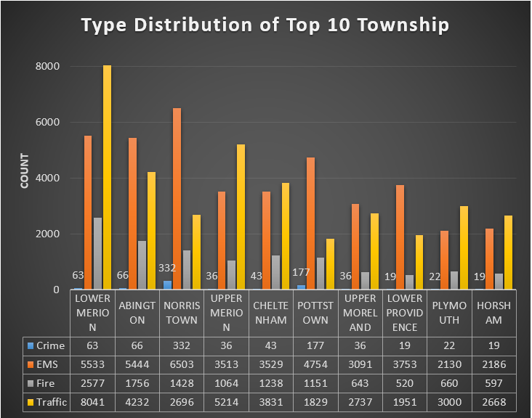
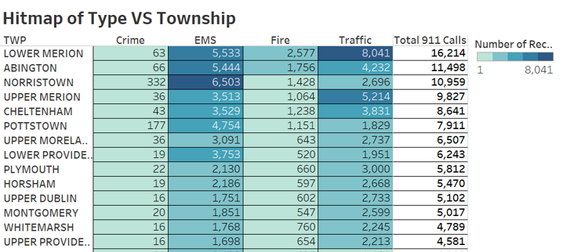
Data Visualization & Interpretation

Slide 12
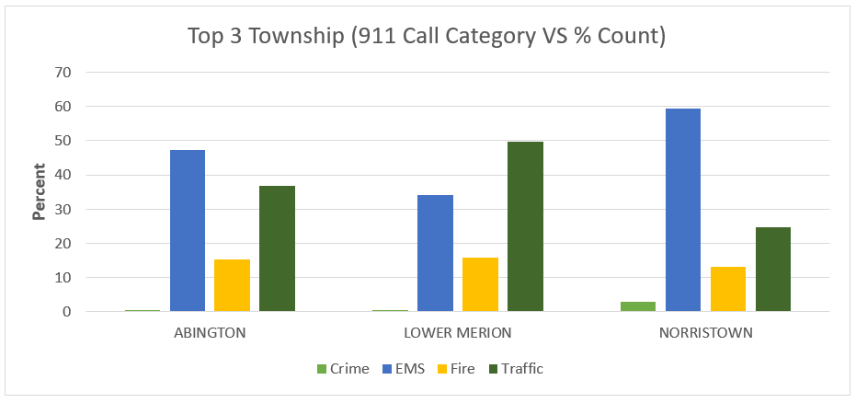
Data Visualization & Interpretation
Normalization formula: Normalized value = (Count of each type / Population density) * 100 (Total count of all type)
Norristown had approximate 60% of EMS calls which is the highest percentage among all 3 township

Slide 13
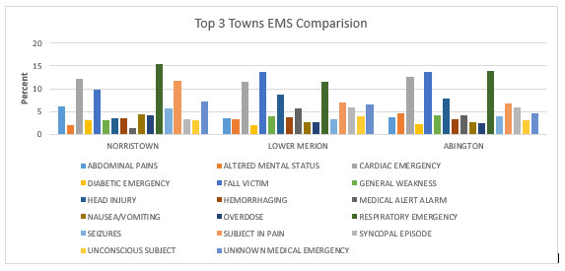
Data Visualization & Interpretation
Norristown and Abington has highest number of respiratory emergency calls

Slide 14
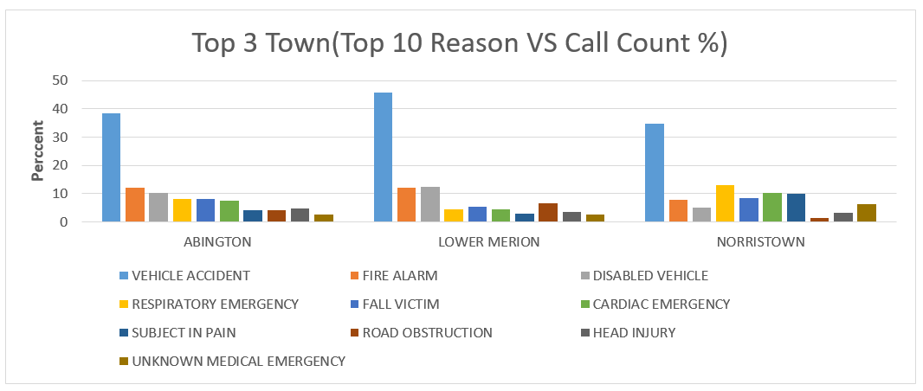
Data Visualization & Interpretation
Vehicle accident dominates the reason for call in all area
The second most reason is ﬁre alarm in Abington and Lower Merion which is strange

Slide 15
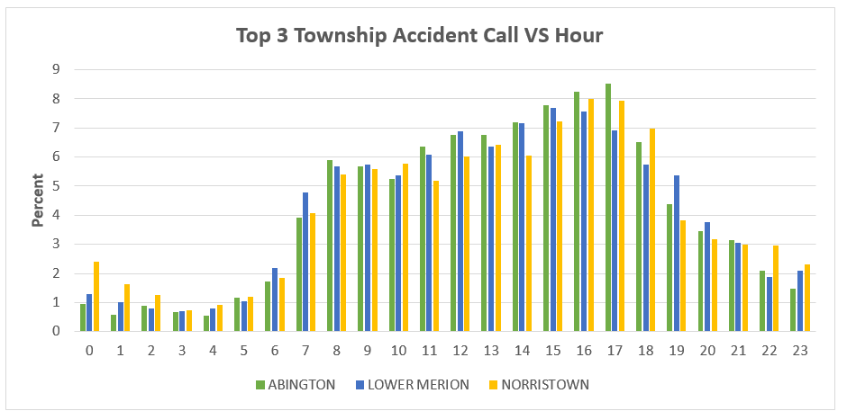
Data Visualization & Interpretation
Norristown had maximum late night accidents
Abington had maximum accidents between 5pm to 6pm

Slide 16
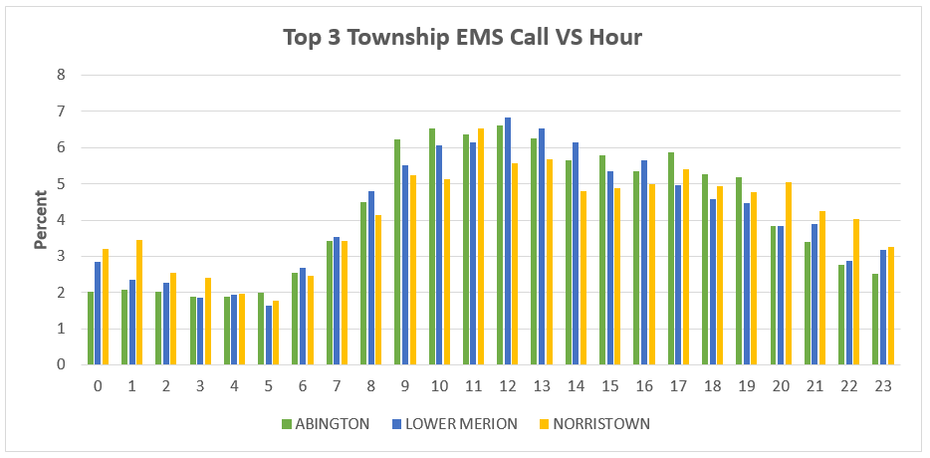
Data Visualization & Interpretation
EMS calls are maximum between 10am to 1pm for Abington and Lower Merion
Norristown has maximum major calls between 10am to 8pm

Slide 17
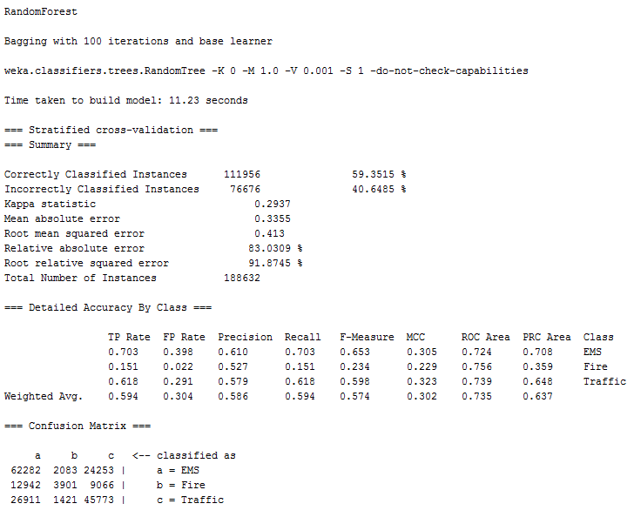
Data Mining
Goal: To predict the type of emergency call based on the area and time at which most emergency calls can be expected from that area.
Feature Selection
Use of Random Forest, Naïve Bayes, J48

Slide 18
Conclusion
Visualization graphs helped to understand:
911 calls are made during 3pm to 5pm
Calls are more on weekday compare to weekends
Traﬃc accidents are maximum during 3pm to 5pm
Abington, Lower Merion and Norristown had maximum 911 calls
EMS calls are the most during 9am to 2pm for the above townships
The results of this analysis can help the public safety services to make strategic decisions about how to fairly allocate ﬁre, medical and police resources

